Slide 1


Research Software MetaData (RSMD) guidelines
Morane Gruenpeter
Software Heritage
Inria, France

Slide 2
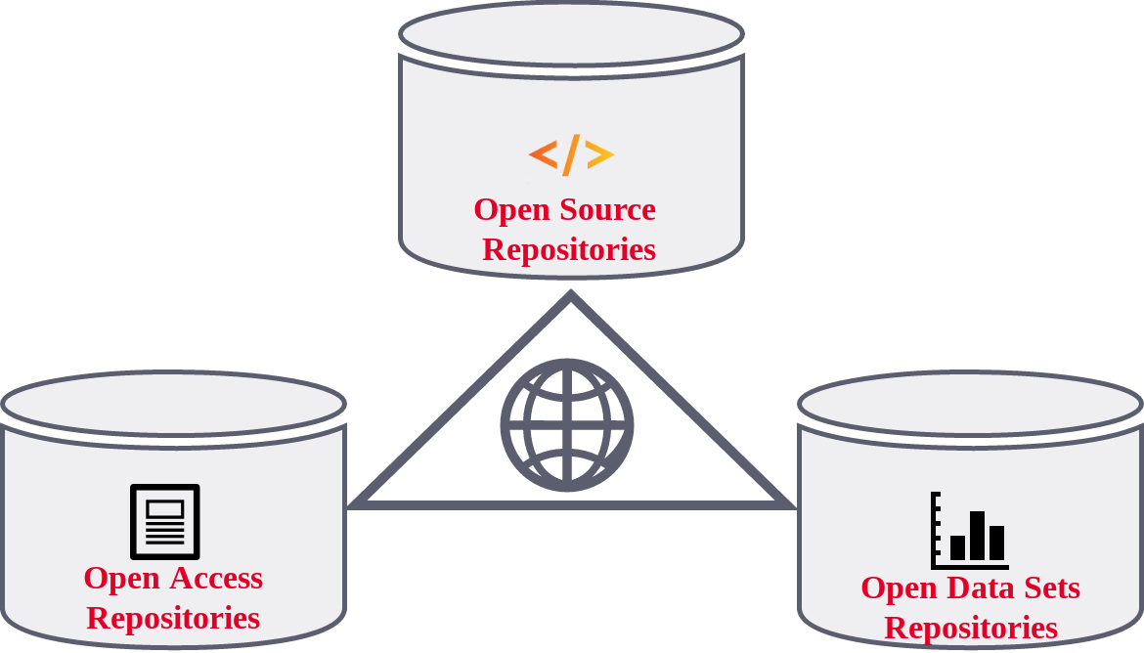
What is Research Software
Research Software MetaData guidelines (RSMD)
Research Software created during the research process for a research purpose Software in research used for research FAIR4RS output: Gruenpeter et al. Defining Research Software: a controversial discussion (Version 1). Zenodo. https://doi.org/10.5281/zenodo.5504016
Three pillars of Open Science
Software Heritage CC-By 4.0 2019
Software has multiple facets:
a tool
a research outcome or result
the object of research
Morane Gruenpeter | IDCC24 | CC-BY - SA | 19/02/2024

Slide 3
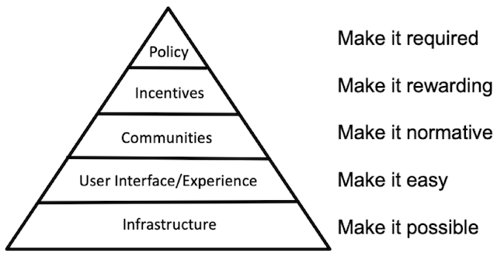
Research Software MetaData guidelines (RSMD)
Who should use the guidelines?
FAIR-IMPACT RSMD guidelines
Pyramid from Strategy for Culture Change: Brian Nosek (2019) https://www.cos.io/blog/strategy-for-culture-change
Morane Gruenpeter | IDCC24 | CC-BY - SA | 19/02/2024

Slide 4





Research Software MetaData guidelines (RSMD)
#RSMD_guidelines timeline
Research Software
Metadata (RSMD) Guidelines
Due: June 2023
D4.4 submission
2024-2025
Dissemination & adoption
March 2023
#RS_Workshop
Co-located
RDA P20
May 2023
#RSMD_guidelines
Community consultation
October 2023
SSC IG session
RDA P21
June 2022
FAIR-IMPACT
Launch
May 2023 CodeMeta
V3.0 release
Sept. 2023 CodeMeta webinar
Morane Gruenpeter | IDCC24 | CC-BY - SA | 19/02/2024
Notes:
The Research Software MetaData (RSMD) guidelines are a cross-disciplinary community driven effort to provide standardized and actionable guidance for the metadata collection and curation of research software.

Slide 5
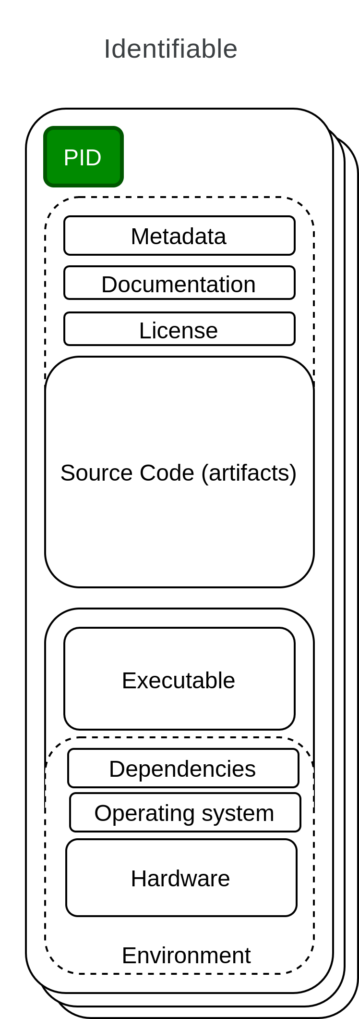
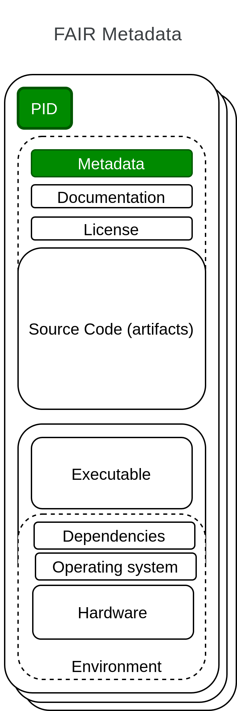
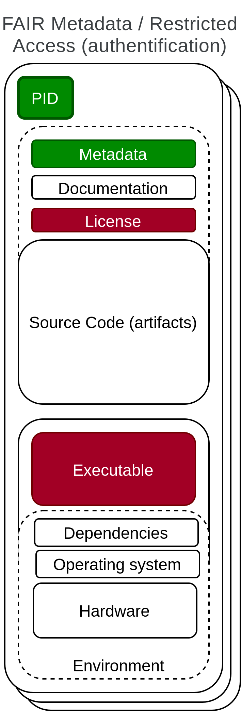
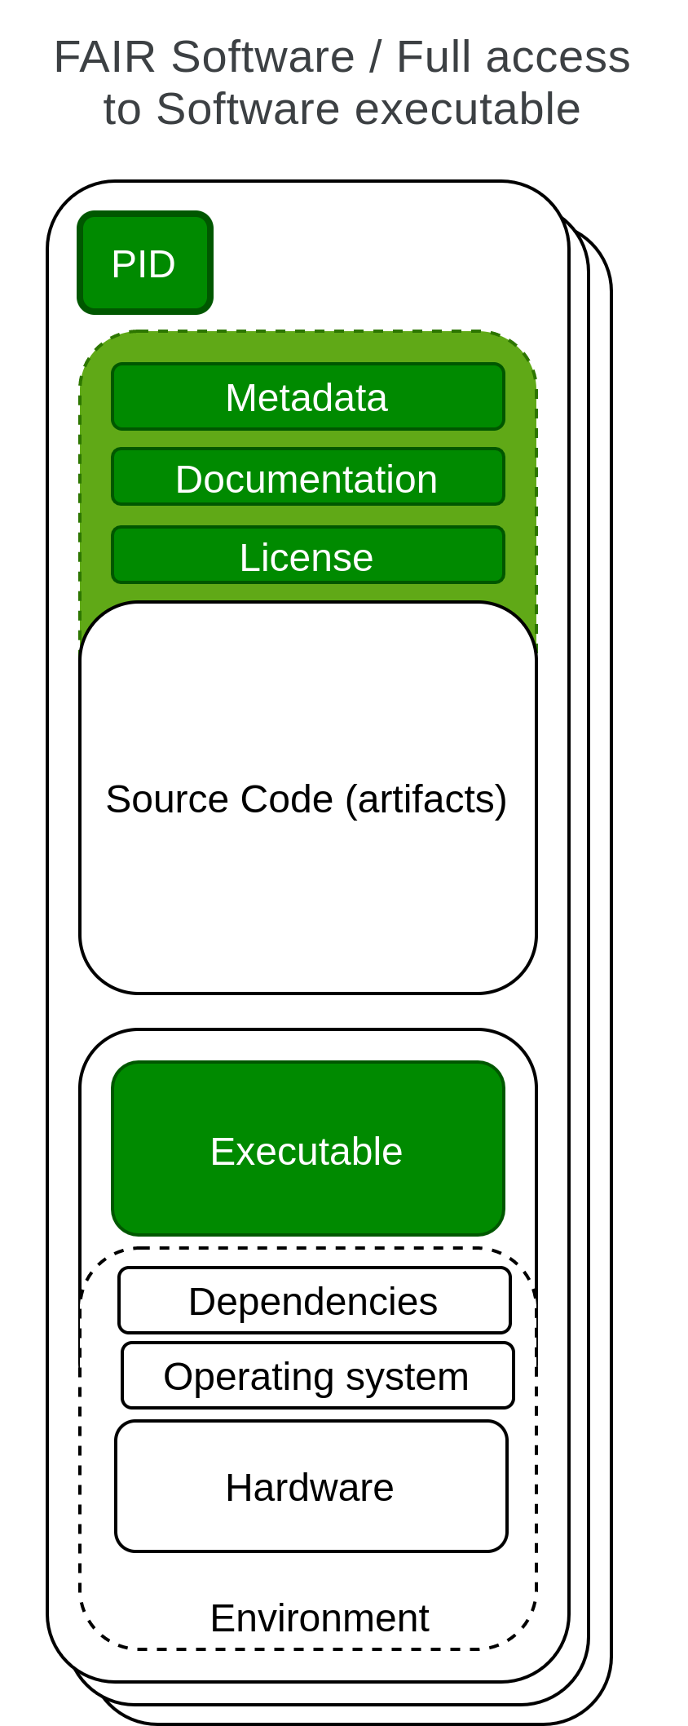
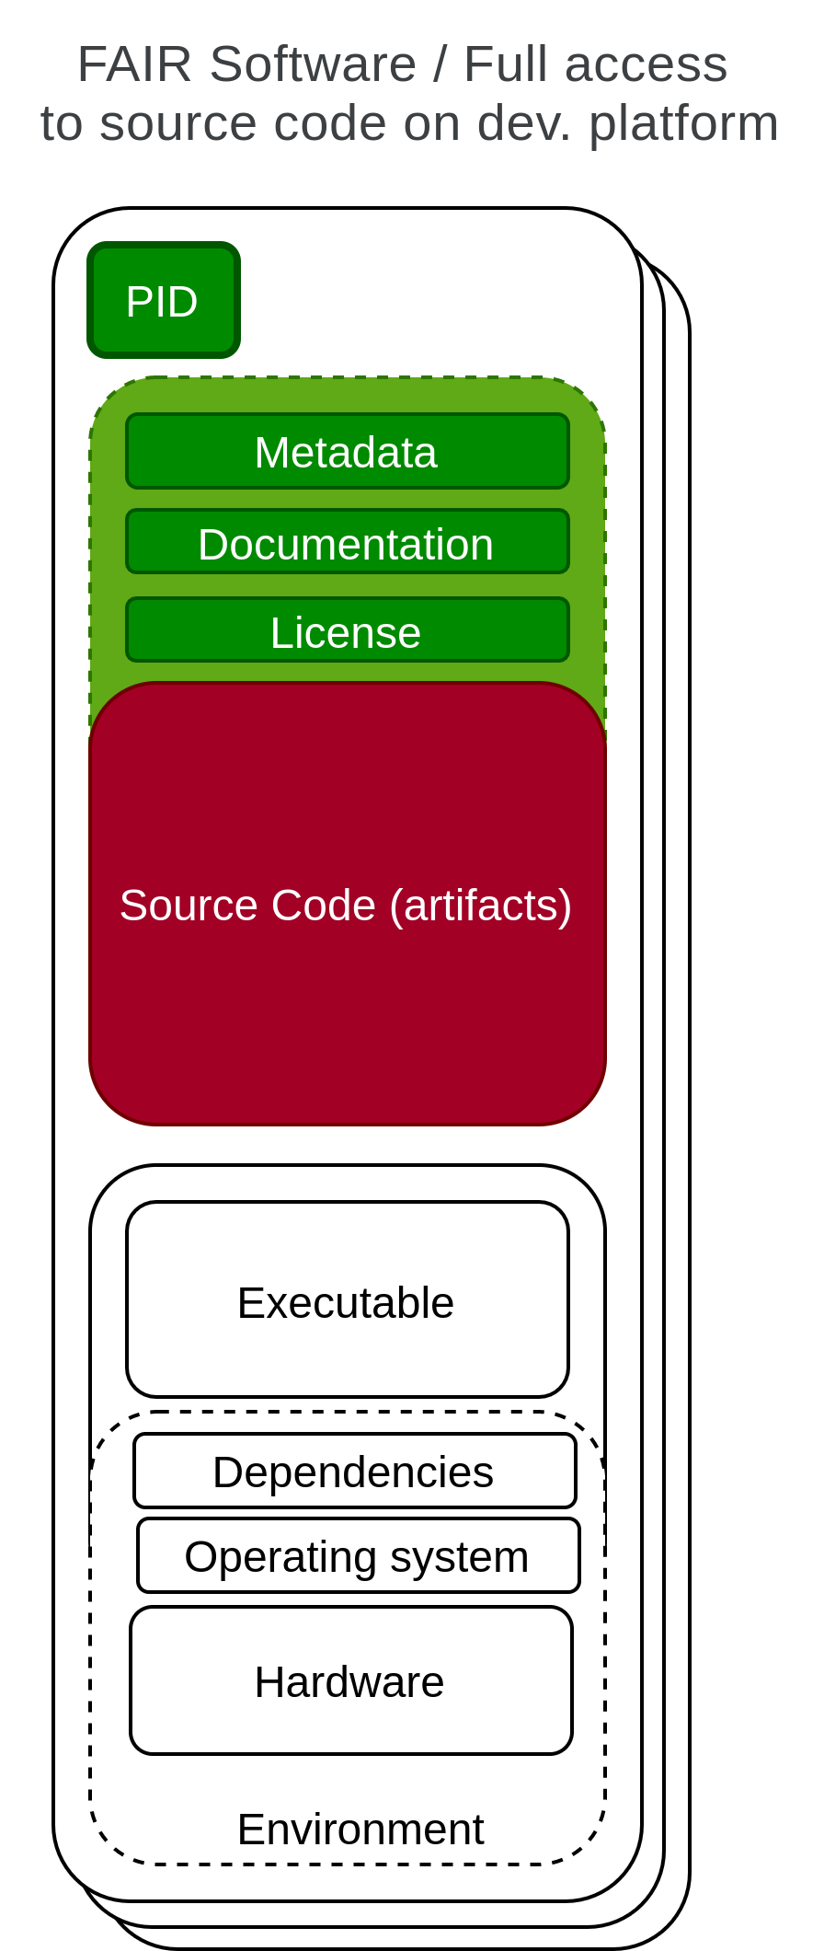
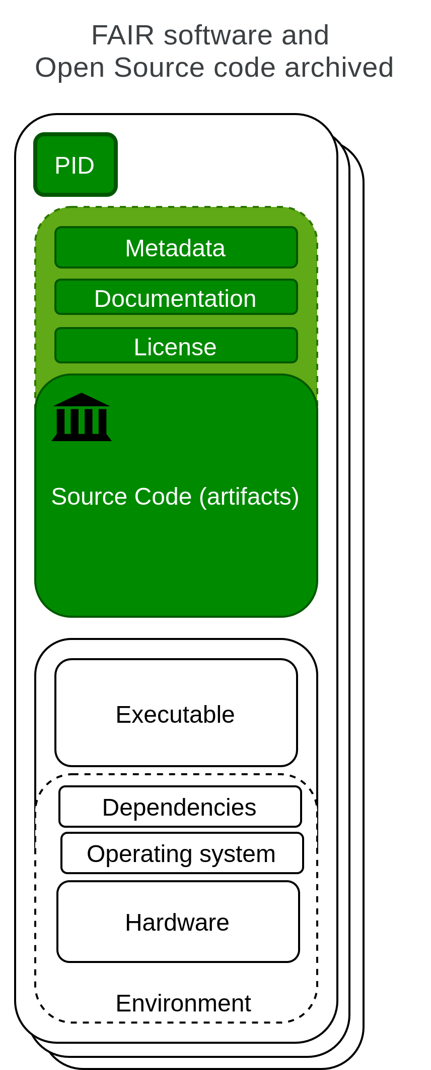
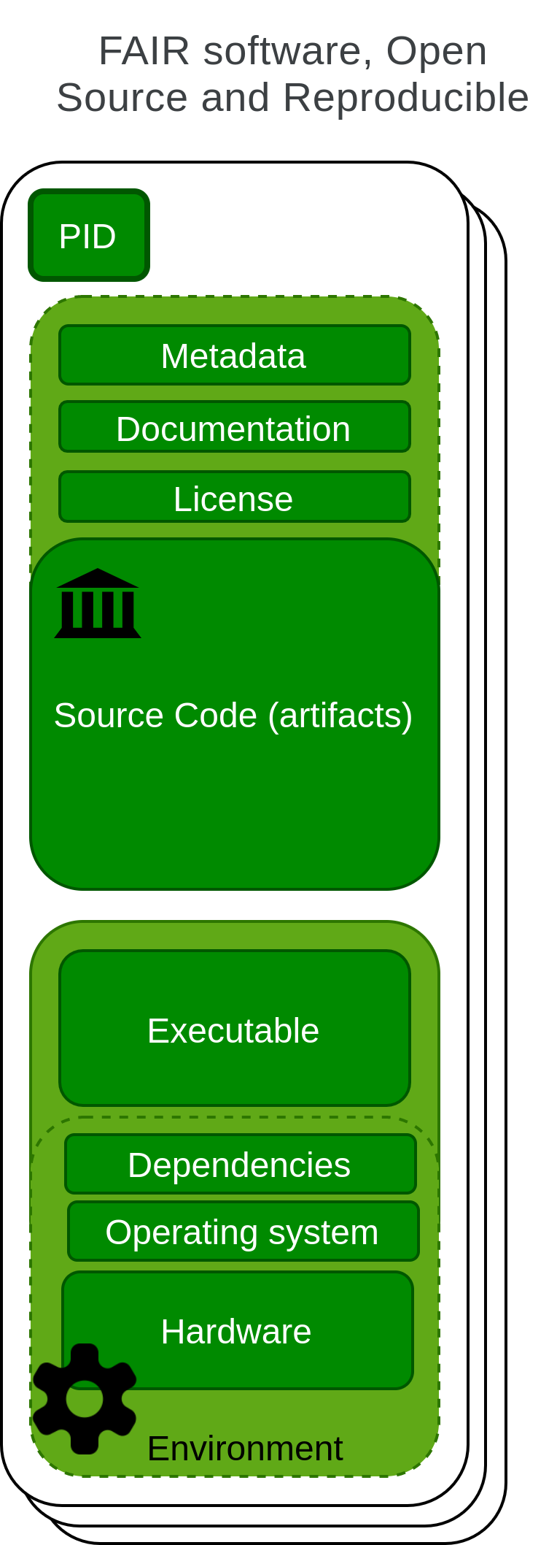
FAIR4RS principles published in 2021
Research Software MetaData guidelines (RSMD)
https://doi.org/10.1016/j.patter.2021.100222
Morane Gruenpeter | IDCC24 | CC-BY - SA | 19/02/2024

Slide 6
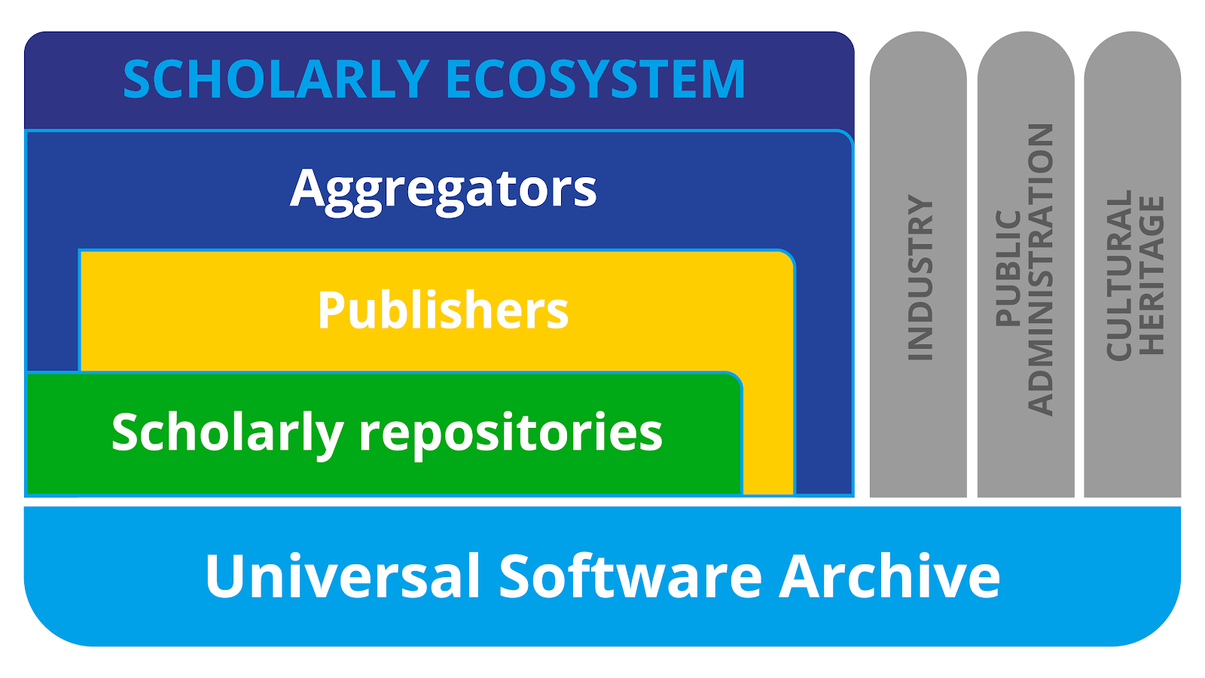
EOSC SIRS report published in 2020
Research Software MetaData guidelines (RSMD)
Scholarly Infrastructures for Research Software
Four Pillars
Archive, Reference, Describe, Credit
State of the Art
Best Practices & Open Problems
Cross Cutting Concerns
Participants
Representatives from 9 infrastructures:
Archives
HAL, Software Heritage, Zenodo
Publishers
Dagstuhl, eLife, IPOL
Aggregators
OpenAIRE, scanR, swMATH
FAIRCORE4EOSC is turning the SIRS report into a reality
WP6 creating the component called RSAC - EOSC Research Software APIs and Connectors
SIRS report: European Commission, Directorate-General for Research and Innovation, Scholarly infrastructures for research software : report from the EOSC Executive Board Working Group (WG) Architecture Task Force (TF) SIRS, Publications Office, 2020, https://data.europa.eu/doi/10.2777/28598
Video: EOSC Software Infrastructures for Research Software: J. B. Gonzalez Lopez (CERN)
Morane Gruenpeter | IDCC24 | CC-BY - SA | 19/02/2024

Slide 7
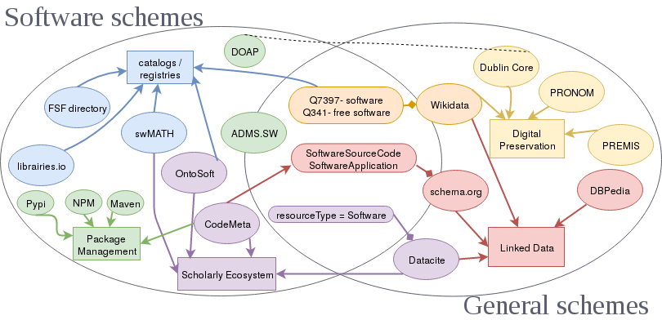
CodeMeta initiative - V1.0 released in 2017
Research Software MetaData guidelines (RSMD)
A subset of schema.org
An academic community discussing software metadata
A crosswalk table - mapping the metadata landscape
V2.0 released in 2020,
V3.0 is expected soon!!
Gruenpeter M. and Thornton K. (2018) Pathways for Discovery of Free Software (slide deck from LibrePlanet 2018). https://en.wikipedia.org/wiki/File:Pathways-discovery-free.pdf
Morane Gruenpeter | IDCC24 | CC-BY - SA | 19/02/2024

Slide 8
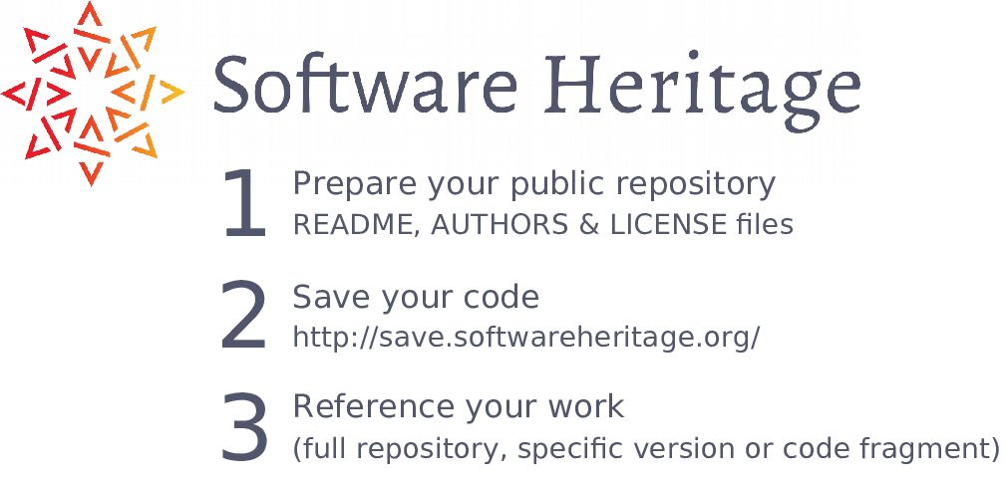
The guidelines for software archival
Research Software MetaData guidelines (RSMD)
https://www.softwareheritage.org/save-and-reference-research-software/
Morane Gruenpeter | IDCC24 | CC-BY - SA | 19/02/2024

Slide 9
Research Software MetaData guidelines (RSMD)
1. General Metadata Requirements
2. Accessibility & preservation
3. Reference & identification
The RSMD seven Aspects
4. Description & classification
5. Attribution & credit
6. Reuse, licensing & legal aspects
7. Re-execute: Dependencies & execution environment
Morane Gruenpeter | IDCC24 | CC-BY - SA | 19/02/2024

Slide 10
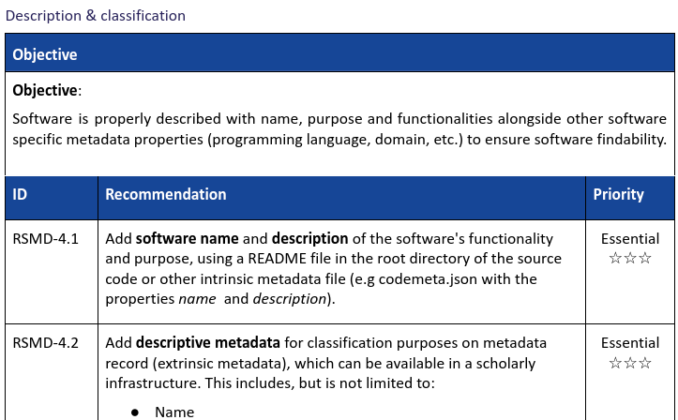
Research Software MetaData guidelines (RSMD)
Each aspect has a high-level objective with a series of practical recommendations
High-level objective
Actionable, detailed recommendations
Priority
Morane Gruenpeter | IDCC24 | CC-BY - SA | 19/02/2024

Slide 11
Who benefits from FAIR research software?
Research Software MetaData guidelines (RSMD)
Researchers
archive and reference software used and created in articles
find useful software
get credit for developed software
verify/reproduce/improve results
Laboratories/teams
track software contributions
produce reports
maintain web page
Research Organization
know its software assets for:
technology transfer,
impact metrics,
Strategy
Curators
verify and curate software metadata
provide documentation on software curation
monitor research teams’ production
Morane Gruenpeter | IDCC24 | CC-BY - SA | 19/02/2024
Notes:
Develop and establish guidelines for the collection and the curation of metadata to archive, reference, describe and cite research software

Slide 12
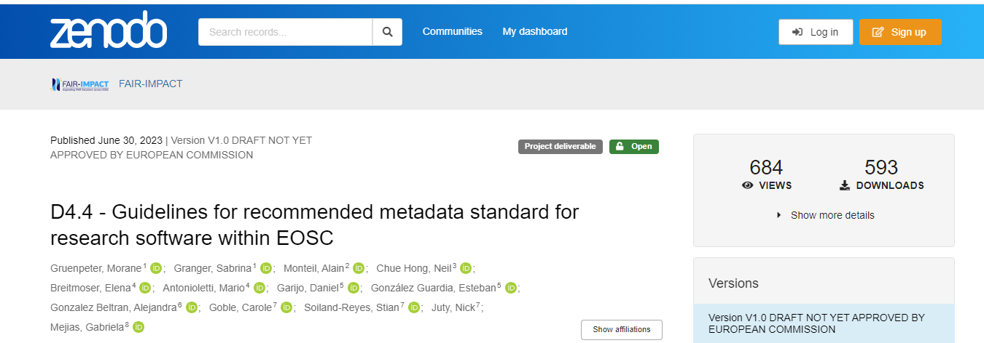
Research Software MetaData guidelines (RSMD)
Want to learn more?
https://doi.org/10.5281/zenodo.8199104
Morane Gruenpeter | IDCC24 | CC-BY - SA | 19/02/2024

Slide 13
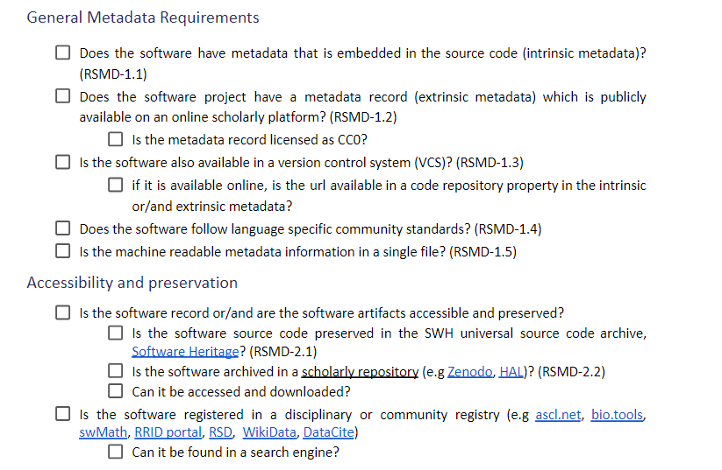
Easy to use checklist to help software creators get started
Research Software MetaData guidelines (RSMD)
Morane Gruenpeter | IDCC24 | CC-BY - SA | 19/02/2024
Notes:
To assist software creators in self-archiving and self-metadata curation, FAIR-IMPACT has created the RSMD checklist as a self contained questionnaire. The RSMD checklist which is addressing all the RSMD guidelines recommendations as a set of questions that can be used by the software creator or the software curator. By using the checklist, software creators can ensure that their software has the necessary metadata to be accessible, discoverable and reusable.

Slide 14

Keep in touch: morane@softwareheritage.org
@moraneottilia, @SWHeritage
https://www.softwareheritage.org/newsletter/

